Slide 1

VE496 Advanced Technical Communication
Week 8, Day 2:
Technical Definitions
Nathaniel T. Murray 莫子禅
Summer 2020

Slide 2



Technical Descriptions of Equipment
Tools
Facilities
Personnel

Slide 3
Basic Technical Definitions
Elements | Term being defined
 | Category to which that term belongs (i.e. a type of…)
 | Features which differentiate it from other terms in this category
Examples | Eosin is a chemical compound used in making red printing ink.
 | The ScanPen 150 is a hand-held scanning device capable of scanning bar and QR codes, as well as text.
 | A soldering iron is an electrical device that applies heat to melt solder and make sound electrical and mechanical connections
Sources: Ewald (2017); Balzotti (2018)

Slide 4
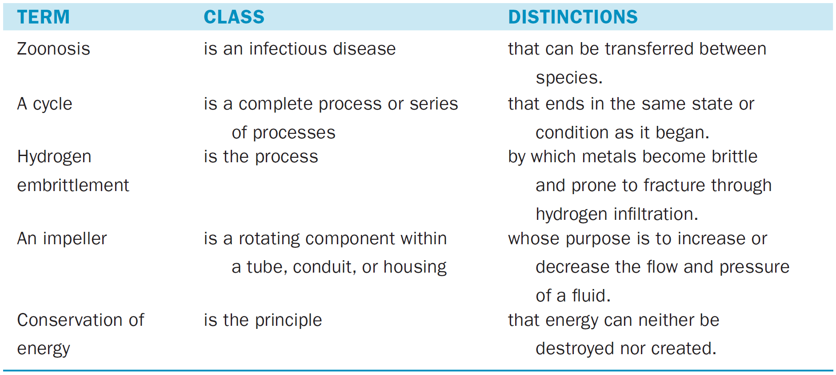
Examples of Technical Definitions
Source: Ewald (2017)

Slide 5
Key Aspects of a Good Technical Definition
Does not repeat the term in the definition
An electrical insulator is a material used for insulating electrons. | An electrical insulator is a non-conductive material used to inhibit the flow of electrons.
Uses qualifying phrases
Mechanical efficiency is the ratio of… | In this report, mechanical efficiency is the ratio of…
Uses audience-appropriate language
Wind power density (WPD) is a calculation of the mean annual power available per square meter of swept area. | Wind power density (WPD) is a measure of how much wind energy is available per square meter of the area that a wind turbine’s vanes sweep while turning.
“Assistive knee braces are a kind of wearable lower extremity exoskeleton that can enhance people’s strength and provide desired locomotion.” (from Sample Proposal with Methodology)
Source: Ewald (2017)

Slide 6
Elements of an Extended Technical Definition
How it works
Component parts
Function/purpose
Physical appearance
History
“It is possible to use knee braces to assist elderly or disabled people on improving their mobility to solve many daily life problems … Some of the designs allow the torsion to be adjusted, giving some variety and further improvement in efficiency over a simple passive device.” (from Sample Proposal with Methodology)

Slide 7
Extended Technical Definition: Process
The data flow pattern of a system is the set of relations in the flow of data from the inputs, between internal processes, and to the outputs. The data flow relations in a properly executing system determine the data dependencies (emphasis original) among processes such that the data flows among processes in a particular order and each process executes only when it has received the necessary data items. In effect, the data flow relations constrain the relative order of execution of the processes based on the availability of required data [55].
Source: Torres-Pomales (2015)

Slide 8
Extended Technical Definition: History
Database marketing, which is a subdimension of relationship marketing with the focus on exploiting data in marketing (Möller & Halinen, 2000), represented a step toward a more sophisticated means of achieving targeted communication and segmentation in the late 1990s and early 2000. Database marketing was concerned with using information about customers and markets to improve the efficiency of firm activities (Cespedes & Smith, 1993). Marketing databases, when implemented wisely, were considered to provide useful assistance to marketing managers in various tasks ranging from daily operations, resource allocation, and budget planning, to strategic decision-making processes (Tao & Yeh, 2003) … Today, customer big data analytics enables even more sophisticated marketing actions and therefore the study proposes that the use of big data in customer relationship management may be the next step in database marketing for managing customer relationships.
Source: Hallikainen et al. (2020)

